Slide 1
Tobacco Use & Mortality Analysis & Predictions
Data Science & Machine Learning Project
By - Shruti Gupta

Slide 2
Introduction
Tobacco use and mortality project involves the analysis of 5 datasets containing information about the drugs, prescriptions, death rates, hospital admission rates etc

Slide 3
Objective
To analyze the deaths due to tobacco consumption based on the given 5 datasets
  Admissions.csv
  Prescriptions.csv
  Fatalities.csv
  Metrics.csv
  Smokers.csv
To integrate the datasets and gather insights
To find relationship between deaths and the factors causing it

Slide 4
Tools & Frameworks Used
Python for EDA
Matplotlib and Seaborn libraries for visualization
Sci-kit learn for ML preprocessing
LogisticRegression and LinearRegression models for Death Predictions

Slide 5
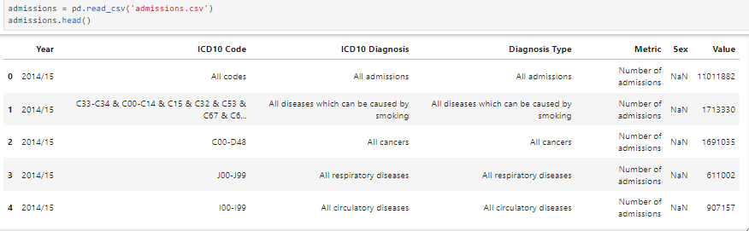
Dataset1 – admissions.csv
First 5 rows of admissions dataset

Slide 6

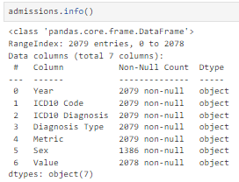

Admissions dataset
Data Cleaning & Preprocessing
Find the size of the dataset
Find the datatypes of the columns
Change dtype of ‘Value’ to numeric
Clean the ‘Year’ column

Slide 7
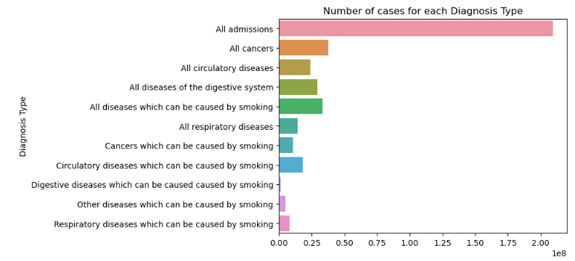
Data Visualization
INFERENCE
Maximum admissions are there for all types of cancers
No. of admissions for each cause

Slide 8
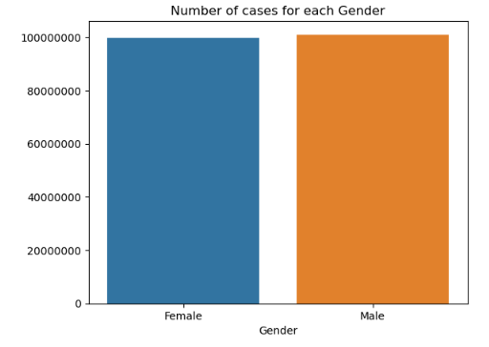
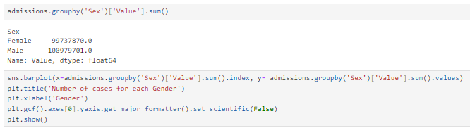
Data Visualization
Gender wise admissions
INFERENCE
There are almost similar admissions reported for both the genders.
However, Males are slightly higher

Slide 9
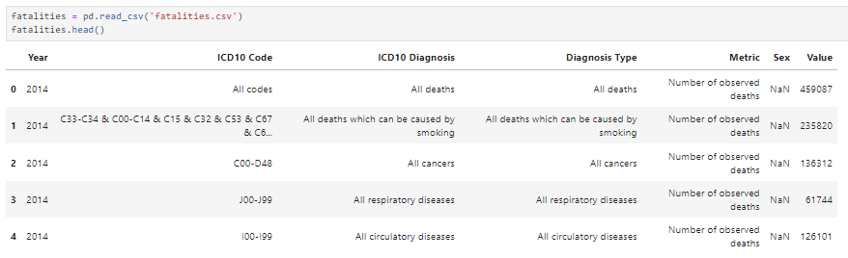
Dataset2 – fatalites.csv
First 5 rows of fatalities dataset

Slide 10


Fatalities dataset
Data Cleaning & Preprocessing
Find the size of the dataset
Clean the ‘Value’ column
Change dtype of ‘Value’ to numeric

Slide 11
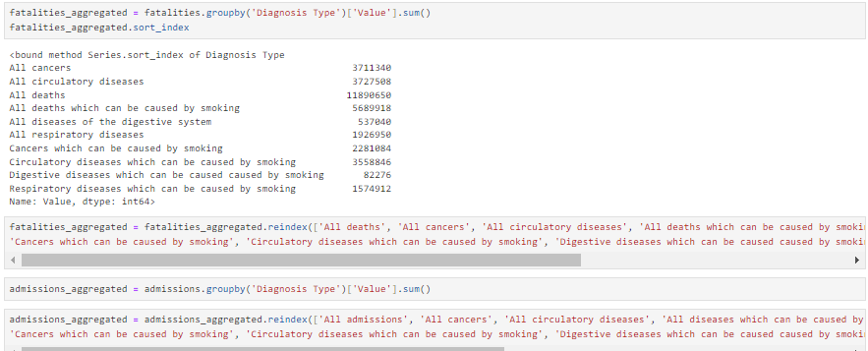
Fatalities & Admissions dataset
Preprocessing
Preprocessing the datasets for better insights

Slide 12
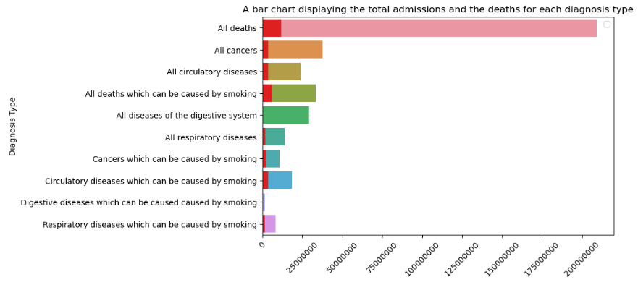
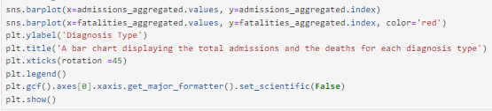
Data Visualization
Admissions and Fatalities for each disease
INFERENCE
The red color denotes the deaths(fatalities) for each disease. The maximum deaths are caused by ‘Smoking’ and minimum by ‘Digestive System’

Slide 13
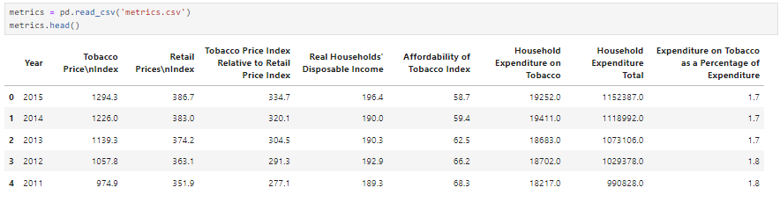

Dataset3 – metrics.csv
First 5 rows of metrics dataset, total 36 records

Slide 14
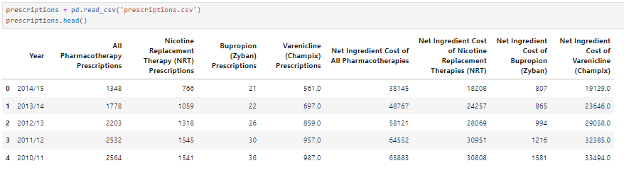
Dataset4 – prescriptions.csv
First 5 rows of prescriptions dataset

Slide 15

Prescriptions dataset
Data Cleaning & Preprocessing
Find the size of the dataset
Clean the ‘Year’ column

Slide 16


Preprocessing for Integrating all datasets
Set the index of all datasets to ‘Year’ column
Change dtype of index to numeric

Slide 17

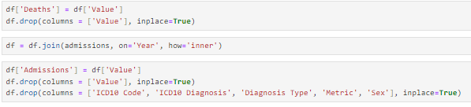
Integrating all datasets
Join the dataset and remove unwanted columns

Slide 18
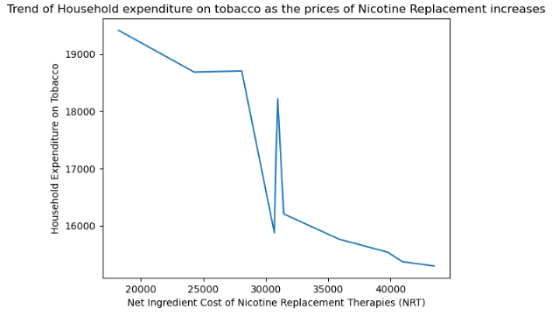
Data Visualization
INFERENCE
As the price of nicotine replacement increases, the household expenditure on tobacco decreases, with fluctuations around 30k
Cost of Nicotine replacement vs expense on tobacco

Slide 19
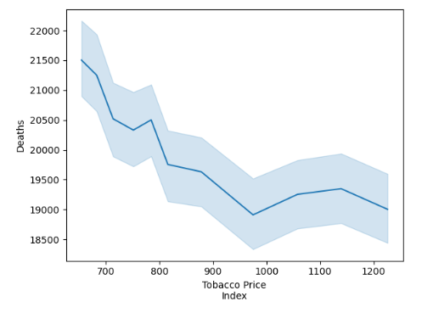
Data Visualization
Tobacco Price vs Deaths
INFERENCE
As the Tobacco price increases, the number of deaths decreases

Slide 20
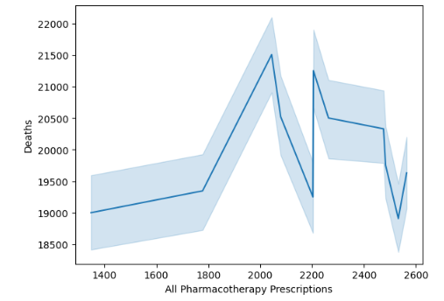
Data Visualization
Prescriptions vs Deaths
INFERENCE
There does not seem to be a correlation between prescriptions and deaths

Slide 21


Feature Engineering
Dropping a few columns and renaming some to create a table for ML

Slide 22
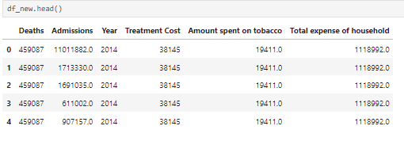
Feature Engineered & Integrated Dataset

Slide 23
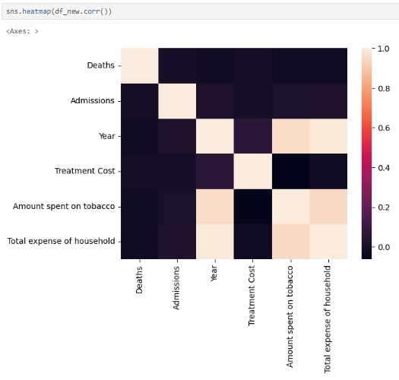
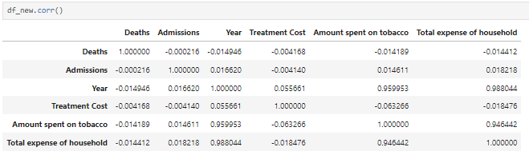
Correlation
Correlation Matrix and HeatMap

Slide 24


Machine Learning
Declare X and Y
Split them into train and test data
Apply LinearRegression OLS model to find the result

Slide 25
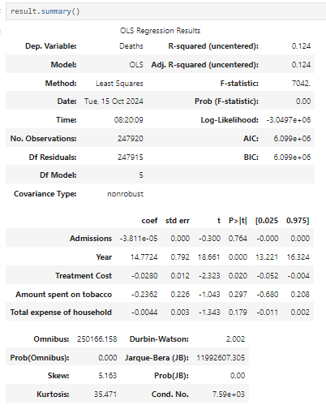
Machine Learning
4. Analyze the results
R-squared value is 0.124 means that ‘Deaths’ are dependent on features by only 12.4%
P-value for the features ‘Treatment Cost’ and ‘Year’ is <0.05, hence they are somewhat related to Deaths

Slide 26
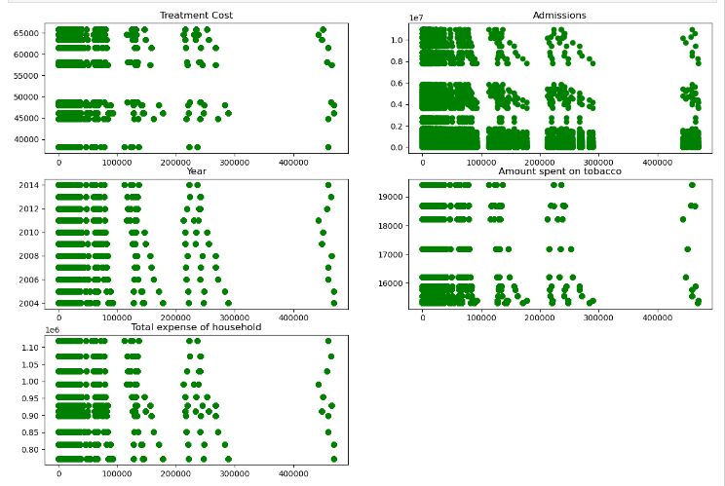
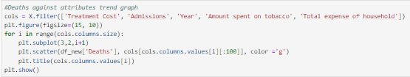
Scatter plots for Deaths vs all the features

Slide 27
Thank You!
Shruti Gupta

